Slide 1
Business Analytics Nano Degree Project 2 Presentation
How was the performance of the Industrial sector in term of the Total Revenue over the period from 2012 to 2016?

Slide 2
Introduction
In this project, I filtered the original data set business on “GICS” to select only the “Industrial” sector. The I divided the data based on the year of “Period Ending” before performing statistical analysis on it.
The main purpose of this analysis is to assess how was the performance of the industrial sector in term of the total revenue over the period from 2012 to 2016.

Slide 3
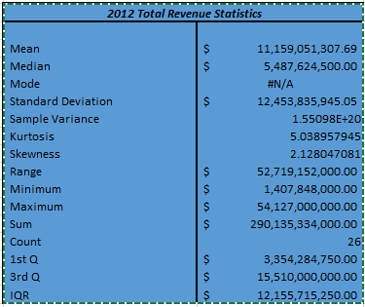
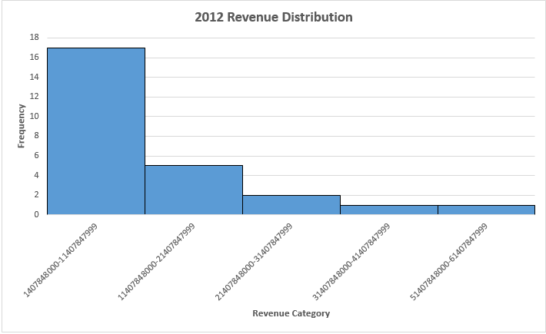
2012 Total Revenue Statistics & Distribution

Slide 4
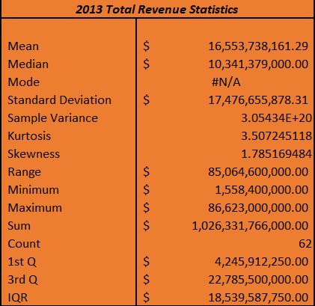
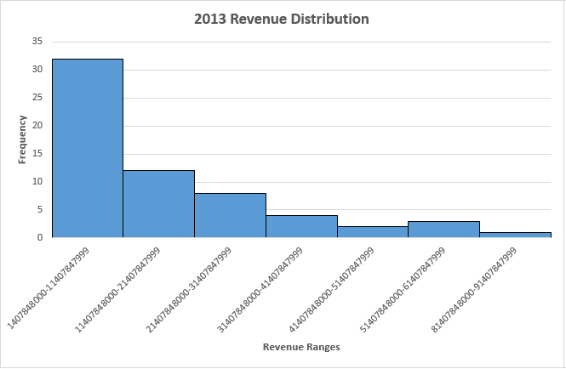
2013 Total Revenue Statistics & Distribution

Slide 5
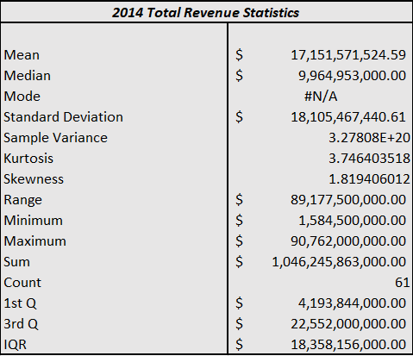
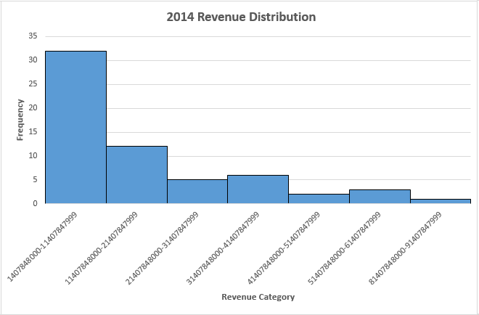
2014 Total Revenue Statistics & Distribution

Slide 6
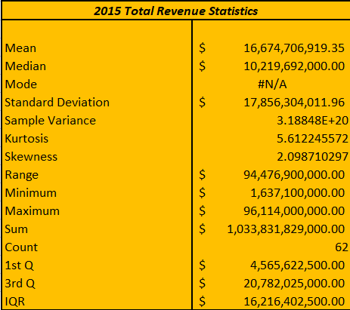
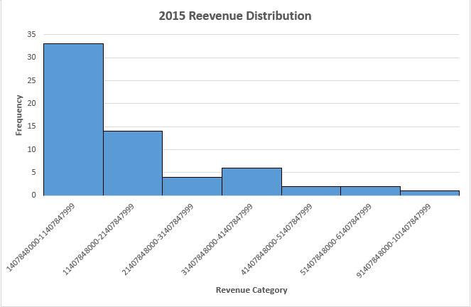
2015 Total Revenue Statistics & Distribution

Slide 7
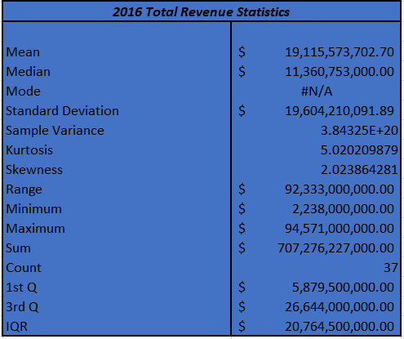

2016 Total Revenue Statistics & Distribution

Slide 8
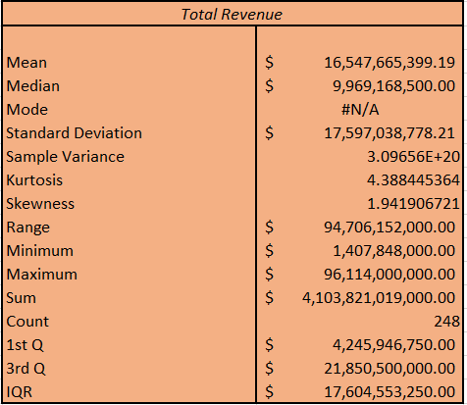
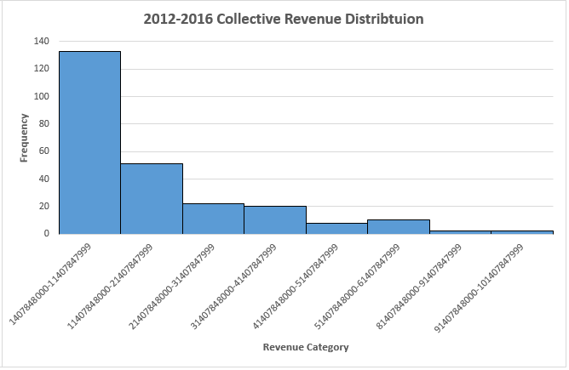
All Years Total Revenue Statistics & Distribution

Slide 9
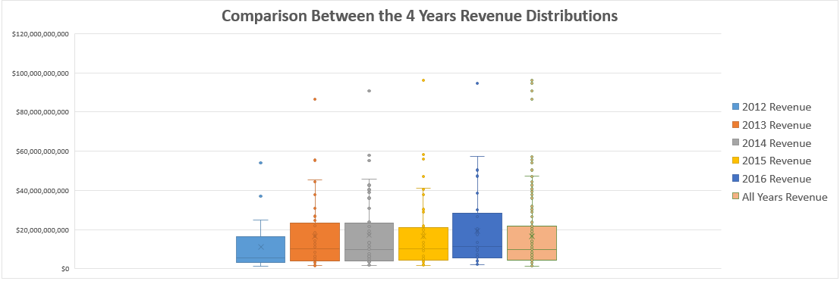
Revenue Distribution for (2012-2016)

Slide 10
Conclusion
In general, the total revenue of the industrial sector increased gently but steadily over the period (2012-2016), while its distribution remained right skewed.

